Slide 1

Art Magazine
by Jaxmine

Slide 2
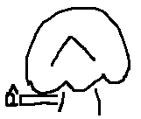
Why an Art Magazine?
I’ve always had a fascination for art and creative design
I really enjoyed the magazine unit and wanted to do it again
I thought I could do better than my past unit, specifically on my front cover
The aim of the magazine is to interview six different artists and designers and see how their background (race, gender, ethnicity, general life experiences, ect.) affects their art
The title is a reference to that
There will also be articles loosely based off of the artists and designers in the magazine
The magazine will be printed instead of interactive
The front cover will be art

Slide 3

What Inspired This?
Title
Other art magazine titles such as GRAPHIC, eye and Apollo being a single word
I liked the lowercase styling of frieze and delve
Premise
I’ve always been interested in the artists and designers perspective, as seen from my questionnaire responses this is also something many people are interested in when they’re reading art magazines
Design
I liked the simplistic page design of magazines such as Canvas
Most art magazines have a simple design, with their logos and pages specifically
I wanted to go with an orange and black colour scheme as they’re both bold colours

Slide 4
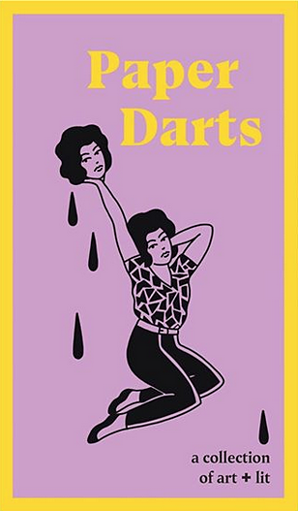
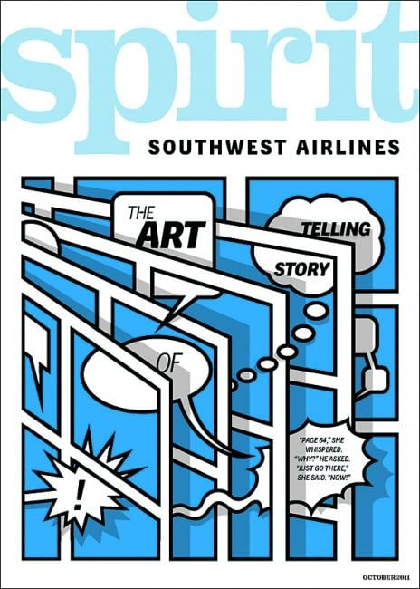
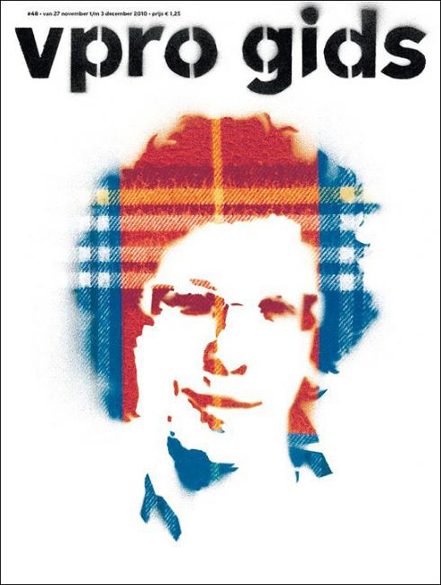
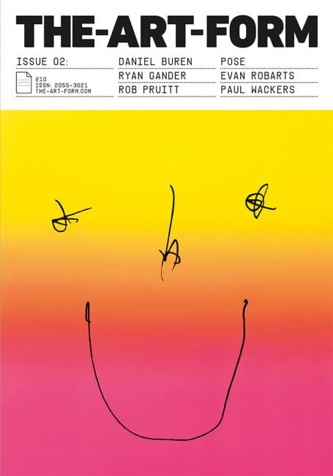
Production Moodboard

Slide 5
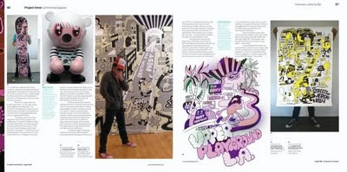
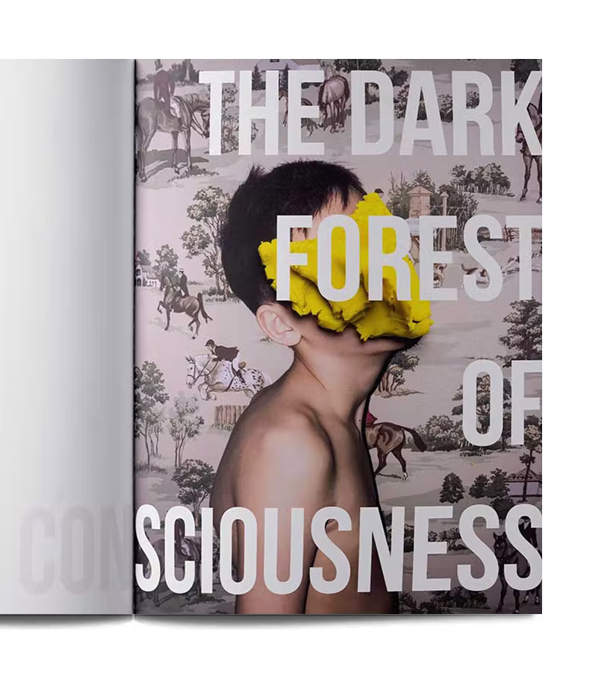
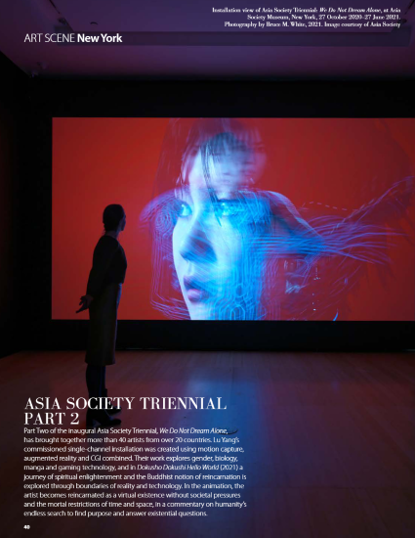

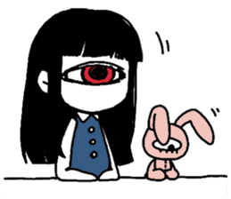
Production Moodboard

Slide 6
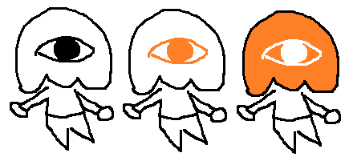
… Mascot?
Design absolutely not final…
Would potentially appeal to 15-19 year olds
Add a personal touch and appeal to the magazine
Would make magazine stand out much more and be more memorable

Slide 7
Initial Research
Secondary
I did research into already existing magazines to see what their articles are about, what their overall design is and what the tone of their magazines are
Laws & ethics with interviews, defamation and copyright laws
Interview techniques
Colour meanings for logo
InDesign research
Effective headlines and article research
Questionnaire
Most would prefer an informal and casual tone, but many people also wanted a mix of both
Made me reevaluate my magazine title and the codes and conventions of art magazine titles
Leaned more on minimalistic design but also said that it depends and should have a bit of variety
I also emailed four different magazine writers from various art magazines and have a focus group that I will show my magazine to while its a work in progress & the final product

Slide 8
Target Audience
Primary
15-19 year olds (casual interviews, drawings/art style, pet article)
Social Grade E (adverts, the magazine being free)
Explorers (new perspectives, different types of art)
Secondary
20-24 year olds (the artists chosen are this age)
Social Grade C1
Reformers (enlightenment on art and the industry)
Tertiary
25-30 year olds (slightly more formal articles)
Social Grade C2
Mainstreamers (adverts, freelance article)

Slide 9
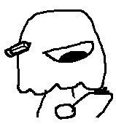
Technical & Logical Resources
Adobe InDesign & Photoshop to create the magazine
Microsoft Word to write the articles
I will also need a camera to take a picture of myself for the Editorial Notes at the beginning, I will request for one during the production stage (week 4-6)
5 artists and designers already secured
Focus group secured, 5 people all fitting the target audience
Magazine writer & designer for proofreading not secured yet

Slide 10
The Schedule
Week 3 (current)
Plan, present and evaluate pitch
Do any additional research from it as well
Prepare for and do the interviews this week (one is on Thursday)
Contact people to be the last artist/designer and hopefully get a writer
Write rough draft of the articles at home, possibly get insight from writer/focus group
Week 4
Additional research due 27th
Finish the articles if not done already
Do the mock up of the magazine
Do a focus group meeting for the mock ups
Week 5: Continue working on rough design and do a focus group for that
Week 6: Work on final design and do a focus group for that, deadline on 17th

Slide 11
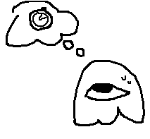
The Schedule
Week 7
Print out magazine if not already done
Get audience feedback from focus group, the people I interviewed and a magazine designer
Post production due on 24th 4:45pm
Week 8
Work on self evaluation by the 26th

Slide 12
The Interviewees
Fantelle (@fantellerhur on Instagram)
Her article is on the history of pet art
Abbsterism (@abbsterism on Twitter)
Her article is on being a freelance illustrator
Emily Zullo (@emilyzulllo on Twitter)
Her article is on the difference between animation and illustration
Nora Zhao (@norazhaodesign on Instagram)
Her article is on the generative art
Lynsey Moore (https://www.lynseymoore.co.uk)
Her article is on costume design and illustration
They will all be interviewed by the 24th at the latest

Slide 13
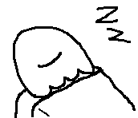
What Can Go Wrong?
Oh don’t worry a lot has already
Waiting on people…..
Still having to contact one artist/designer to have six people
My focus group being slow to answer questions
I have yet to hear from any of the writers I contacted
I can do the art for the front cover but that’s not ideal
I’ll try to work ahead of schedule and send off responses earlier than I need to
I’ll contact people in different ways from emailing them if I can
I can talk to the art college students and see if anyone will volunteer
One of the questions in the questionnaire lets artists and designers that are willing to be interviewed put their socials in so I can contact them
There are people in the focus group who are willing to be one of the interviewees

Slide 14

More Research
Once I secure the last person to interview I’ll have to do research for an article on them
I still have to find & contact magazine designers and find a writer who’ll respond back
And any of your suggestions!

