Slide 1





Interactive magazine
FASHION
By
Jaxmine

Slide 2

INTRODUCTION >>
I always knew I’d enjoy this unit as I like creating designs and always found it fun. I was excited to get onto designing the magazine but at the same time was worried for it, I was concerned I’d judge myself too critically for it not being exactly as I envisioned
I planned to do a fashion magazine from the start, fashion is the first thing I think of when thinking about magazines and I already liked the designs of them. I was very set on doing a fashion magazine from the beginning and never thought about doing a different genre. I did plan to make the magazine focus on street fashion, but at the end it ended up becoming a mix of different fashion styles (alternative fashion, formalwear, casual, ect.)

Slide 3


RESEARCHING >>
I conducted a list of primary research I had to do, this list would help me create my magazine. I looked at professional fashion magazine covers such as ELLE, marie claire and Cosmopolitan
The covers and the codes & conventions of their designs
Their articles and what these types of magazines write about
Sustainable brands to promote in my magazine
I also did some research to help me on the video that would be in my interactive magazine
The fashion industry as it was the main focus of my video
How to have creatively designed videos
Tips on how to have an effective voice over
I didn’t originally intend for sustainability to be the focus of the magazine but decided that it would be a good way to tie the video and the magazine together, otherwise the video might’ve look out of place on a page
I also had audience feedback multiple times during and after the production, such as the copy editors and the feedback I got from a friend once I was done. Another thing I did was ask questions to a focus group and then shared a questionnaire with others to help me layout the magazine. I asked questions that would later determine some of the subjects on the magazine, such as the Q&A poll and the image to text ratio I wanted to aim for

Slide 4

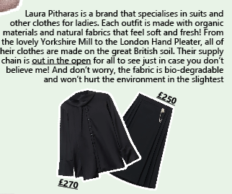
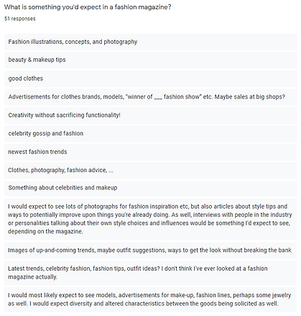

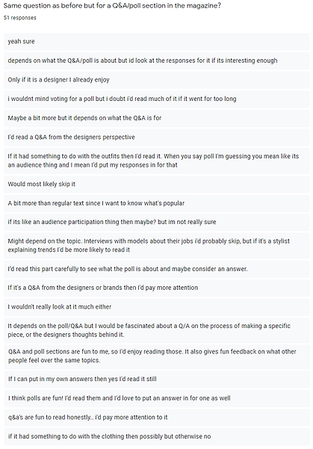

RESEARCHING >>
My most important findings ended up being from the questionnaire and the original list of research I did for the magazine. The layout of the magazine (like the many images in the pages) was inspired by their answers and while I came up with the Q&A poll myself, the questionnaire reinforced my idea by saying that they would read it

Slide 5
RESEARCHING >>
The least effective was the first questionnaire I did and the research on having creative videos. While the first questionnaire I did had the same questions as the second one did, I made mistakes by not making all the questions required and didn’t distribute it to nearly enough people. I’m happy I retried doing my questionnaire as my second attempt helped me a lot while planning the magazine. I followed some of the tips in the videos I watched to make creative videos but overall it didn’t help me much in the long run
One of the suggestions made by one my copy editors was to recommend some brands that fit the new poll section (bold, casual, alternative), but I didn’t have the time. While this was a minor thing to add, doing this research would’ve allowed me to have more interactive elements on my page
My research skills have definitely improved from my previous units, as I was in charge of what I was researching I felt that all of my research was relevant to my work. My commentary was more detailed because of this and I also wrote my research narratively as I continued

Slide 6
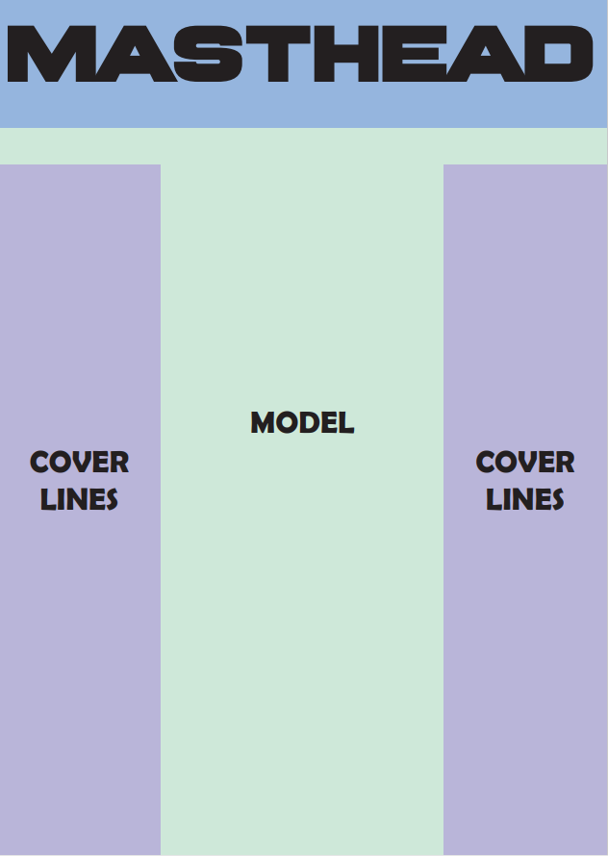
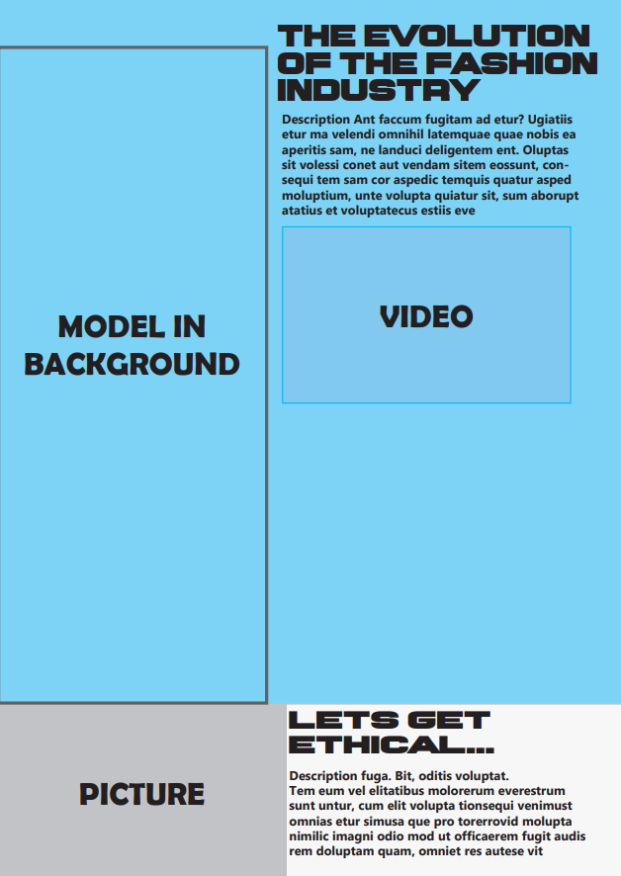
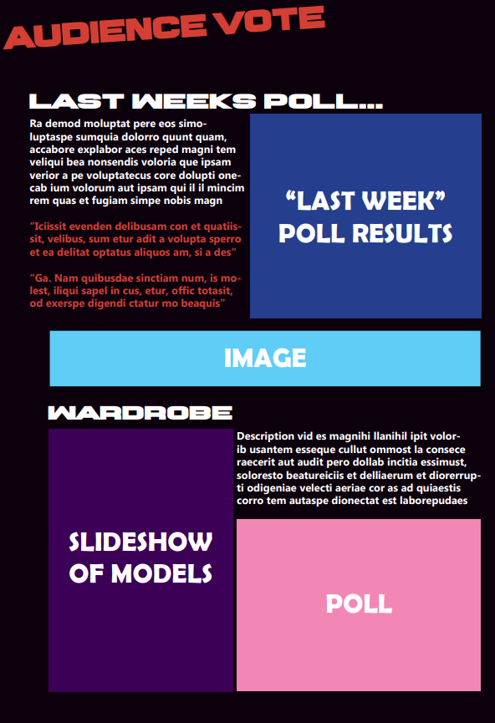
PLANNING >>
The initial design for my front cover was very different from my final magazine cover, mostly because I didn’t know how to format it at the time. Despite my research into front covers I found that I didn’t like how it’s normally formatted and wanted to try something different with it, but I didn’t know what to do. I considered doing a landscape front cover to stand out from the others but realised that might be too difficult to design around. I had no trouble with the layout of the pages though and knew instantly what I wanted to do. Looking back on my mockups, the front cover is slightly different from what I was going for

Slide 7
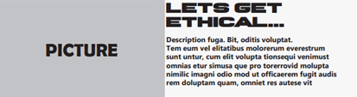

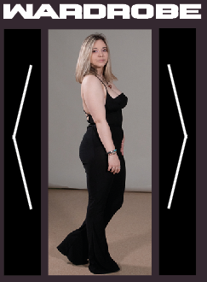
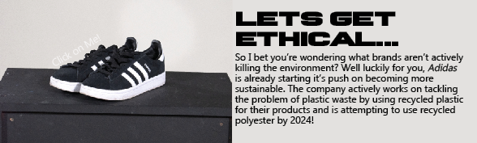
PLANNING >>
Everyone had to do a video for their interactive element, but I chose to also do a slideshow and a hyperlink originally. I also added interactive buttons that change colour when hovered over or clicked on and wanted to add an interactive textbox, but I couldn’t get the interactive text box to work. I always knew where I wanted these interactive elements to go, the slideshow would be part of the poll and the hyperlink would be a link to buy the shoes, so planning was very simple
mock-up
mock-up
final
final

Slide 8


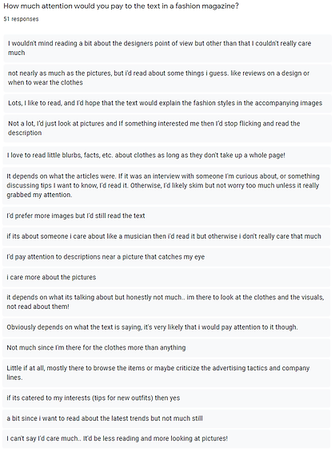
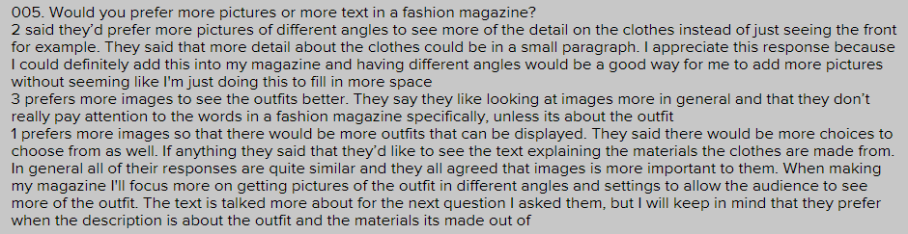
PLANNING >>
I had to do original photography and as this was a fashion magazine, that meant I also had to have models. I took photos of two models, myself and shoes for my magazine
Writing my articles was easy as my tone had to be easy going, fun and informal. I also didn’t have to write as much as all of my research had mentioned that they’d prefer images over text and that they’d most likely skip paragraphs of text

Slide 9
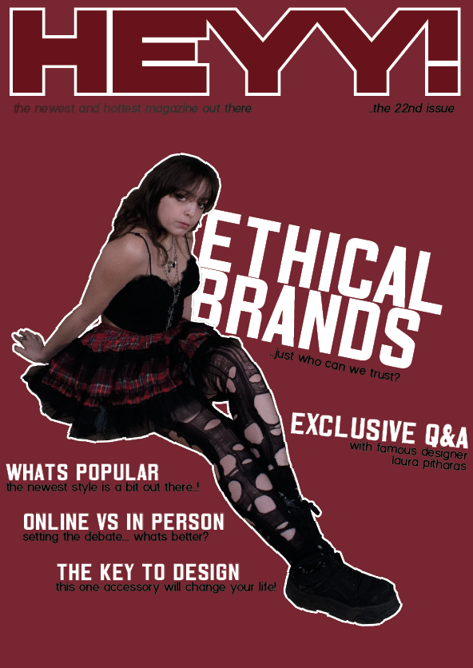
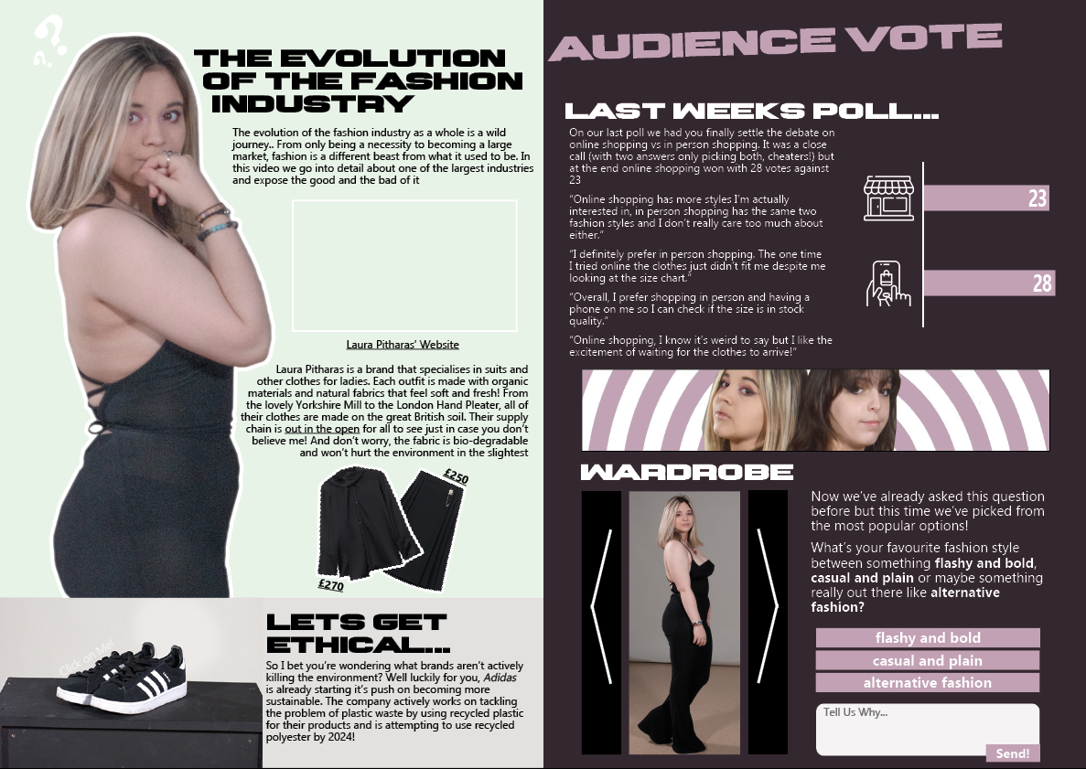
PRODUCT >>
This was the final design of my magazine and I’m quite proud of it, especially the double page spread
theres a video
here i promise

Slide 10
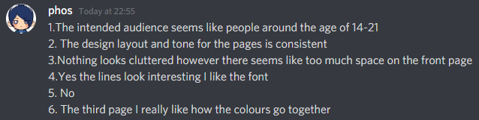
PRODUCT >>
The double pages definitely met what I was going for (minimalistic and sticking to only a few main colours) and came out the best. I used multiple techniques while making the magazine like Buttons & Forms for the buttons in the Poll section, using Multi-state objects to create a slideshow and using Colour Range in Photoshop to make the swirl design background. The slideshow was originally what I’d include for an interactive element, I wanted the buttons to also be interactive as they’re meant to be and I had to use Colour Range as the original background was only black and white and I wanted to change the colours
My magazine is reflective of professional standards because it follows the codes & conventions in magazines. The masthead in the front cover has a masthead right at the top which is an absolute staple of fashion magazines and most magazines in general. I also have different cover lines, the main and secondary cover being bigger than the others (Ethical brands and exclusive Q&A). I have the issue no. in the front cover (22nd issue) as well. The articles are around the model as they’re always the main focus of the cover, which is also another staple of fashion magazines. While I didn’t use the model as a background, it’s also common for that to not be the case at times. There are buzzwords such as “Exclusive” (a suggestion I had from a copy editor) are also on the cover
The original target demographic of my magazine was for young women and teenagers, this is reflected by the one colour background being easy on the eyes but still eyecatching, the text having an informal tone, the overall simplistic design of the magazine and the models all being feminine. This was clear as all my feedback knew too

Slide 11

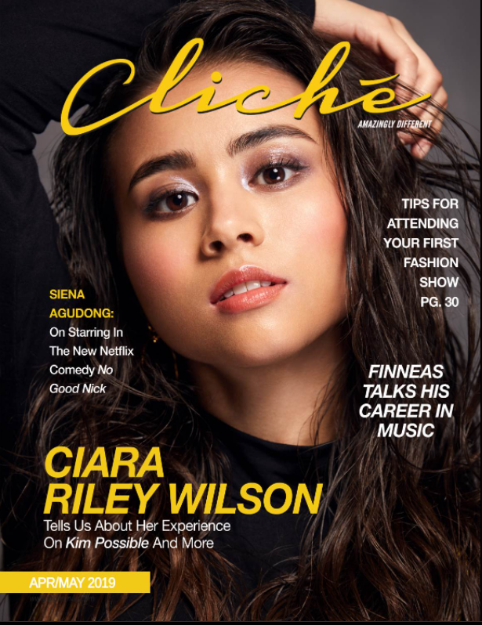
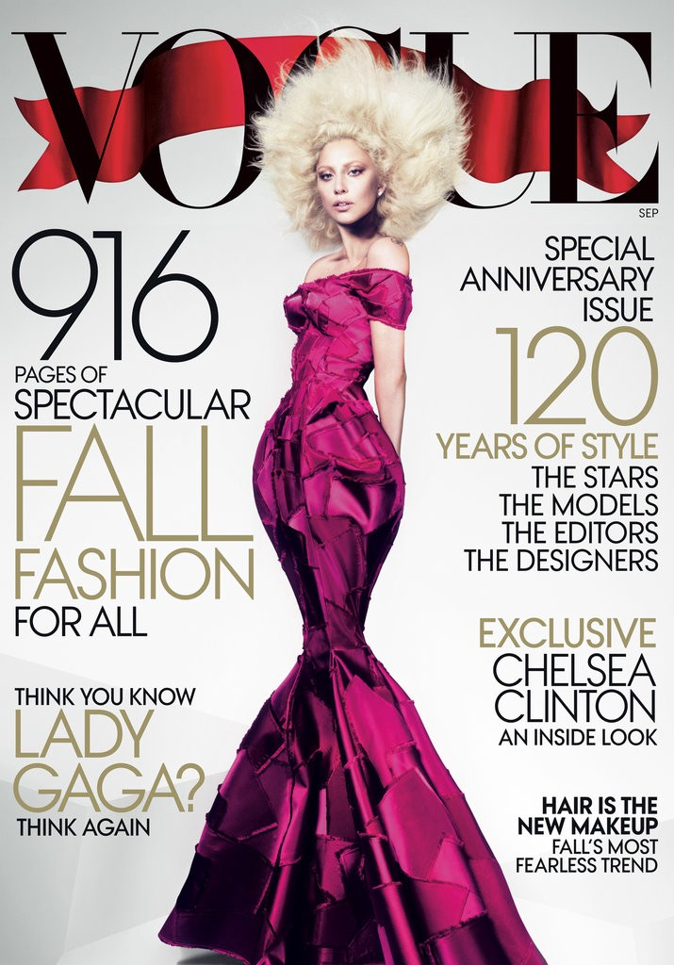
PRODUCT >>
Main and secondary cover being bigger than the rest
Articles “surrounding” the model
Plain background to highlight the model
Issue number underneath the masthead

Slide 12
PRODUCT >>
While I do think the front cover is better than the draft version, I’m still not completely satisfied with it and think it could’ve been improved. I think there’s too much negative space on the front cover and that while it does match with the double page spread now, it feels a little bit too bland. I asked my friend as she’s in the target demographic (girls & teenagers) about the front cover and she also agrees that there’s too much space
I learned about the importance of planning out a design before deciding to go through with it and how to use InDesign. At first I was a bit confused by how the program worked and I had to tweak the workspace for it to be bearable for me (having to turn off Frame Edges as it annoyed me or being confused by the poor quality of my photos and then learning I had to turn High Quality Display on). For my first time being introduced to InDesign I think I did quite well and while I had to follow tutorials to do some things (such as the slideshow), it was worth my time as I got the slideshow to work in the end

